Slide 1
Learned from Software Engineering Project
-By Chao Li, Yang Zheng, Bing Li

Slide 2


Purpose:
This presentation is for what we learned from this project, and the experience we can share with others. Which includes both technical skills and communication experience.
and

Slide 3
Aganda
Project organization
Technical experiences
Reducing complexity.
Using existing framework (UI).
The interaction between backend and UI.
Testing.
Cooperation experiences
Grouping program team.
Communication with other teams.
Communication with project leader.
Following the basic procedures.

Slide 4
Project Organization
Structure of Use case diagram team:
Algorithm: Chao Li, Yang Zheng, Bing Li
Backend: Chao Li
UI design: Yang Zheng, Bing Li
UI: Yang Zheng
Database: Chao Li
Test: Bing Li

Slide 5
Technical experiences Reducing Complexity:
Using Abstraction and inheritance in the code.
Here is an example in my code:
UseCaseAssociation.java
ExtendAssociation.java
IncludeAssociation.java
ExtendAssociation and IncludeAssociation are inherited from UseCaseAssociation.

Slide 6
Technical experiences Reducing Complexity:
Design the data model to describe the use case diagram data.
Using Functional in the code.
Every task will be finished by single function.
Different tasks will be placed in different functions.

Slide 7
Technical experiences Reducing Complexity:
Experiences share with others:
How to make your code more readable.
Giving your variable a meaningful name.
Making comment in your code.
How to make your code more reusable.
Keeping the code Dry. Dry means less repeat code.
Making class/method do just one thing.
Using framework but not start from scratch.

Slide 8
Technical experiences Using existing framework (UI):
Experiences share with others:
Using popular existing frameworks
Using existing frameworks can save a lot of time than implementing the functionalities in by our own.
Popular existing frameworks are more reliable because they are usually implemented by powerful software company or highly-experienced software communities.

Slide 9
Technical experiences The interaction between back-end and UI:
Using JSON：
Traditionally, the front-end developer has to know a lot the back-end servlets/actions and its corresponding parameters.
Using JSON we contain all data and pass them to one URL
Back end Developer and Front-end developer can work in parallel.

Slide 10
Technical experiences Testing:
Experiences share with others:
Using JUnit before UI is implemented:
Defining the test case and expected result.
After test, we could check whether the test result is matched with our expected result.

Slide 11
Cooperation experiences Grouping program team.
We are responsible for back-end, UI and testing respectively.
We have functionally related.
Back-end and UI are intercepted.
UI uses JavaScript to help back-end to validate data.
Testing make sure every function runs well.

Slide 12
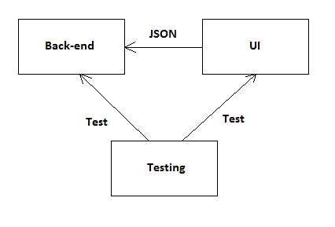
Cooperation experiences Grouping program team.
Experiences share with others:
When grouping a team, all objects in the same team should be functionally related.

Slide 13


Cooperation experiences Communication with others.
Communication with other teams:
Let them know what functions you need from them.
Let them know what functions you have done for them already.

Slide 14
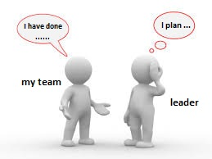
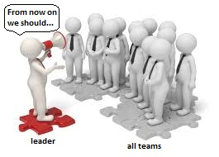
Cooperation experiences Communication with others.
Communication with project leader:
Report working processes to the leader in time.
Then the leader can make a clear plan for the whole project.

Slide 15
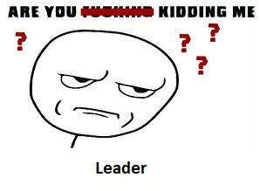
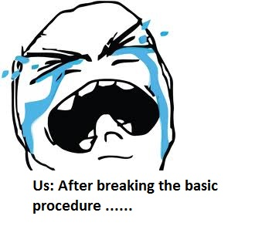
Cooperation experiences Communication with others.
Following the basic procedure:
It is very important to follow the basic procedure that is made by the management team or leader. Because they will get clear idea about what you have finished. Otherwise

Slide 16
Questions?
?

Slide 17
Thank you

